Slide 1
Security and confidentiality policy

Slide 2

Security and confidentiality policy compliance
The security and confidentiality policy are specified in the following documents (including but not limit to)
Employee Handbook
IT policy
Employment agreement
Confidentiality and Intellectual Property Agreement
Everyone has the opportunity to read and ask questions about the provisions.
Everyone must strictly comply with the policy.

Slide 3
Office Security Access
Visitors must register entry and departure time at the front desk and wear a visitor card. Visitors must be accompanied by employee at all times while in office.
来宾应在前台登记进出时间并佩戴来宾卡, 来宾需在公司员工陪同下，进入办公区。
Access cards are non-transferable
门禁卡禁止转借
Each employee must swipe their own card when entering the office
刷一次门禁卡只能允许一人进入办公室

Slide 4
Documentation Security
It is forbidden to take pictures of GDC confidential information (confidential information refer to the confidential information from Level A to Level C which defined by company, include but not limit to different kinds of documentation, meeting notes and white board information )
禁止拍摄公司各类保密信息（保密信息指公司正式划分的A级到C级保密信息，不限形式，
包括但不限于各类文档，会议纪要，白板信息等）
Documentation (electronic & printed) shall be protected from being taken out without permission. Documentation includes databases and data files, system documentation, user manuals, training material, operational or support procedures, continuity plans, fallback arrangements, and archived information.
任何人未经批准，不得将文档（电子的或打印的）带出公司。文档包括：数据文件，系统
文档，用户手册，培训资料，计划书，存档文件等。

Slide 5

Data Protection
Employees should not use or install any software from outside sources (including the Internet and e-mail) on the Company’s computer system unless it has (i) been scanned for viruses, and (ii) been approved by the General Manager or an authorized computer system administrator
在公司的计算机系统上，员工不得使用或复制从别处（包括因特网和电子邮件）得到的
软件。除非在以下情况下：（1）已被扫描杀毒的；（2）经总经理同意或计算机
系统管理员许可的。

Slide 6


Computer and Network Resource
To ensure both Perficient and project related information security all computers must be configured to use a password-protected lock screen. The lock screen should appear within 3 minutes (1 minutes is recommended). All users must lock the computer screen when leaving their desk for any reason.
为了确保项目和公司的信息安全，所有的计算机都必须设置有密码保护的锁屏。
在不超过3分钟（建议时间为1分钟）屏幕静态后锁屏将会出现。不管任何原因离开
办公桌时，都必须锁住电脑屏幕。
Non-approved software is not allowed to be installed, non-approved software includes but is not limited to all Peer-to-Peer (P2P) software. Only legal and licensed software can be installed on any Perficient device.
不可擅自安装任何未经批准的软件，这包含但并不局限于P2P软件，只有合法的有许可
证的软件才可以用于公司计算机。

Slide 7

Password
Computer/laptop password must follow the following criteria and must be changed from time to time:
计算机密码必须符合以下标准, 并要经常修改：
It must contain at least one numeral
至少包含一个数字
It must contain at least one letter
至少包含一个字母
It must contain at least one symbol
至少包含一个符号
It must be at least 7 characters in length.
至少有七个字符的长度
Password should be changed regularly and should not be reused. Passwords should be changed at least every 90 days.
密码需经常改动而且不能重复使用, 密码至少每90天更换一次。

Slide 8

Computer/Laptop
Individuals should not change computer/laptop system configuration such as computer name, domain, or IP.
个人不能改变电脑的系统配置，例如计算机名，域名，或IP地址。
All laptops assigned to users must be returned to Perficient IT upon termination. Assigned laptops can not be given to another person prior to being returned.
所有分配给个人借用的手提电脑都必须在离职前归还给IT部门。在归还给公
司前不得将借用的手提式电脑给他人使用。

Slide 9

Email and the Internet
The company provides a specified email system for business. All email information is the property of the Company.
公司提供专用的电子邮件系统用于公司业务，所有的电子邮件信息都属于公司财产。
The employee should not use a client’s email system to conduct Perficient business unless the business is related to the Client.
员工不能用客户的电子邮件系统来处理博克软件的业务，除非该业务与客户有关 。

Slide 10
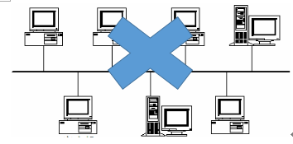
Non Perficient Computer
Non-Perficient computers not allowed to connect to any corporate domains.
非博克软件公司的计算机不能加入到任何的公司域中。

Slide 11
Discipline and Penalties – Level A
Level “A” violation refers to any infraction or misconduct which has negative effect to normal operation or interests of the Company. The Company will give out written warning when an employee commits a level “A” violation
A类违规或渎职行为：此类违法或渎职行为会对公司的正常运转和公司利益产生不利影响。
对于具有A类违法或渎职行为的职员，公司将给出书面警告。
Allowing unauthorized persons to enter the office.
允许未经批准人员进入办公室。

Slide 12
Discipline and Penalties – Level B
Level “B” violation refers to any negligent intentional or repeat wrongdoing or misconduct which may cause harm or has already caused harm to the normal operations or interests of the Company
B类违规或渎职行为：指任何渎职行为、重复性的错误行为或是不法行为，此类行为可
能或已经损害到公司正常的运转或利益。
For any employee who commits a Level “B” violation the Company will issue a written warning and record the violation in the employees personnel file.
对于具有B类违规或不当行为的职员，公司将给出书面警告，并将其记入个人档案。
Being absent from work for one day without a valid reason or approval.
无正当理由或未经允许缺席一天。

Slide 13
Discipline and Penalties – Level C
Level “C” violation refers to any serious or intentional wrongdoing or misconduct which may result in or has already resulted in severe damage to the normal operations or interests of the Company, co-workers or society. C类违规或不当行为：涉及所有有意的、严重的错误行为或不当行为，此类行为可能或已经对公司正常的运转、同事或社会利益造成严重损害
Upon discovery of a Level “C” violation, the Company shall treat it as a disciplinary violation and may result in the immediate termination of the Employment Agreement and employment relationship.一旦发现Ｃ类违规或不当行为，公司将其作为违纪处理，该种违纪行为会导致可能立即解除劳动协议，终止劳动关系
Intentionally discloses the Company’s business secrets or other confidential information to third parties or competitors. 有意将公司商业秘密或其他机密资料泄露给第三方或竞争对手
Engages in work for other companies of any kind whether paid or not, without written permission of the Company. 没有公司书面许可，在其他公司、企业从事任何有或无报酬工作
Collect salary information or compare salary, or willfully discloses his/her own compensation to others. 收集员工薪资信息或比较其他员工的薪酬信息，或故意向他人泄露自己的薪酬信息

Slide 14
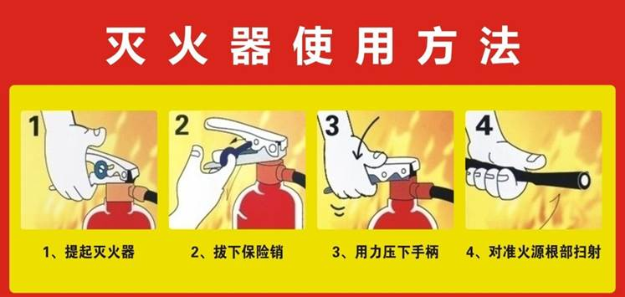
Fire Protection – Fire Extinguisher Usage
There are 7 fire extinguisher boxes with 2 fire extinguishers inside each box in the office, please operate it as the instruction indicated.
公司内部分布了7个灭火器箱，每个箱子中有2个灭火器，请按照以下说明操作灭火器

Slide 15
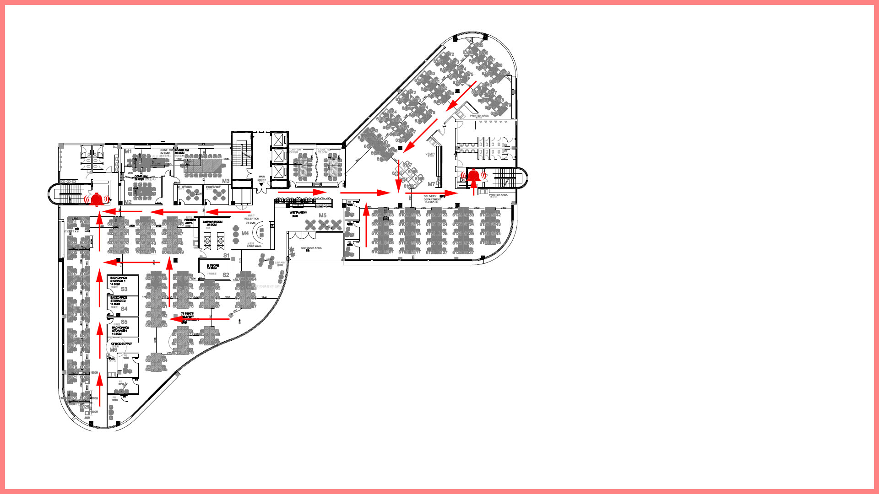
Fire Protection – Emergency Evacuation
When you push the emergency evacuation door, the alarm bell will ring
当你推动紧急撤离门的时候，报警装置将会自动鸣叫

Slide 16
Document Confidential Levels
Confidential Level A - "Highly Confidential" (Tagged as "Confidential A")
"Highly Confidential" documents shall be distributed between GM/CISO/Directors/Administrators (Documents will be tagged as "Confidential A")
Confidential Level B - "Internal" (Tagged as “Confidential B”， this Tag is not Required)
Employee must to apply for permission to obtain the rights
Confidential Level C - "Public" (Tagged as “Confidential C”， this Tag is not Required)
All employees have the default permission to read

Slide 17
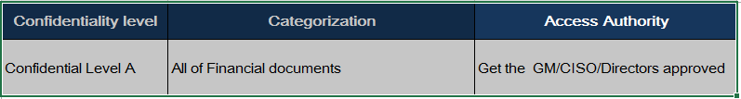
Confidential Level Policy in Financial

Slide 18
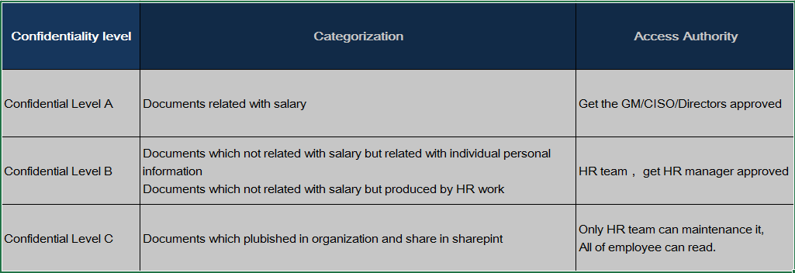
Confidential Level Document in HR/Admin

Slide 19
Confidential Level Documents in HR/Admin(Sample)
ID | Documents | Confidentiality level
1 | Salary related
- | Monthly payroll documents | A
2 | Housing fund related
- | Housing fund withdraw record | B
3 | Policy and Process
 | GDC > HR | C

Slide 20
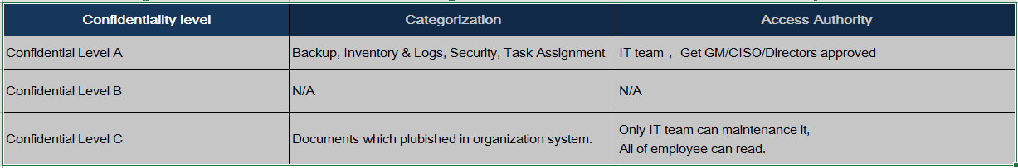
Confidential Level Policy in IT

Slide 21
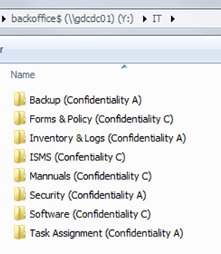
Confidential Level Documents in IT(Sample)

Slide 22
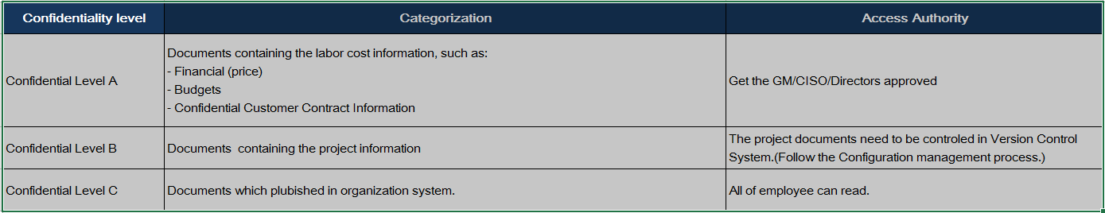
Confidential Level Policy in PMO

Slide 23
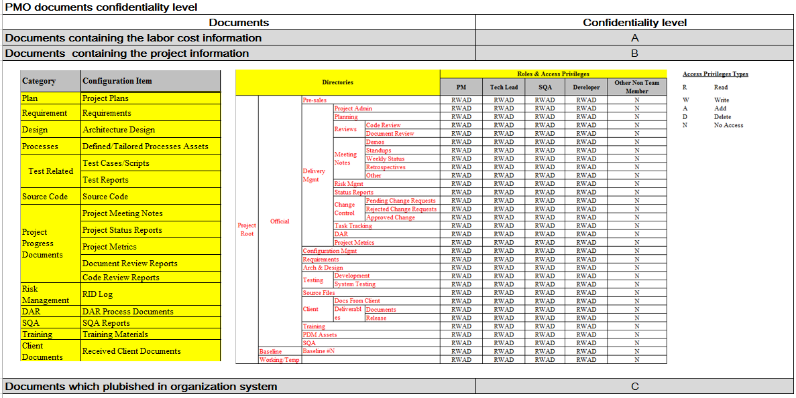
Confidential Level Documents in PMO(Sample)

Slide 24
What to do next
Go to wiki to learn the Security and confidentiality training slides
https://wiki.perficient.com/confluence/pages/viewpageattachments.action?atl_token=k-TmczS8qo&pageId=78676672
https://wiki.perficient.com/confluence/display/GDCPMO/Perficient+China+ISMS+Policies+and+Procedures+%28ISO27K%29

Slide 25
Thank You !

